Slide 1



NURSES' WEEK'24
NURSING FOR ALL:
ADVOCACY, EQUITY AND EXCELLENCE IN CARE
Presented by:
Peter Alabi

Slide 2




0
OVERVIEW
》Advocacy & It's Key Elements
》Equity and Its key elements.
》Excellence and its key elements.
》Interconnection of the Concepts
》Final Words.

Slide 3

INTRODUCTION
Nurses are the heart of healthcare.
During Nurses Week, we celebrate the vital role nurses play in transforming healthcare. We advocate for patients, promote equity, and strive for excellence in care. Nursing is more than care - it's advocacy, equity, and excellence."

Slide 4


ADVOCACY IN NURSING
ADVOCACY IN NURSING means more than just caring for patients; it involves standing up for patients' rights, ensuring their voice is heard, and promoting the best interests of the individuals and communities we serve.

Slide 5





KEY ELEMENTS OF ADVOCACY
Represent-
ation
Empowe-
rment
Policy
Influence
Patient-Centered Care
Acting on behalf of those who cannot represent themselves effectively (e.g., vulnerable populations).
Educating and equipping individuals to make informed decisions about their care.
Advocating for systemic changes to improve healthcare access, quality, and fairness.
Ensuring patients’ voices are heard, their needs are met, and their rights are protected.

Slide 6
KEY ELEMENTS OF ADVOCACY
Ethical Decision-Making
Systemic Change
Advocacy&Support
Purpose
Acting as a mediator to navigate ethical dilemmas in healthcare.
Speaking up for policy reforms to address healthcare disparities and improve access to care.
Championing the needs of marginalized groups who face barriers in accessing quality care.
To achieve health outcomes that are not determined by social, economic, or cultural factors.

Slide 7

EQUITY IN CARE
HEALTH EQUİTY means everyone, regardless of their background, deserves fair and equal access to healthcare services. Nurses are on the front lines, working tirelessly to close the gaps in healthcare disparities.

Slide 8
KEY ELEMENTS OF EQUITY
Accesi-bility
Fairness
Cultural Competence & Sensitivity
Reducing Disparities
Removing barriers to healthcare for disadvantaged groups.
Ensuring that care and resources are distributed based on need, not privilege.
Advocating for systemic changes to improve healthcare access, quality, and fairness.
Identifying and addressing health inequities caused by race, socioeconomic status, gender, or geographic location.

Slide 9

KEY ELEMENTS OF EQUITY
Access to Resources
Work place Equity
Purpose
Ensuring all patients have equitable access to the necessary tools, treatments, and information to achieve optimal health outcomes.
Promoting fairness in opportunities, resources, and respect for all nurses within healthcare organizations.
To achieve health outcomes that are not determined by social, economic, or cultural factors.
Minority groups are 1.5 times more likely to face barriers to healthcare access. Nurses are instrumental in overcoming these challenges, ensuring all patients have access to the care they need.

Slide 10
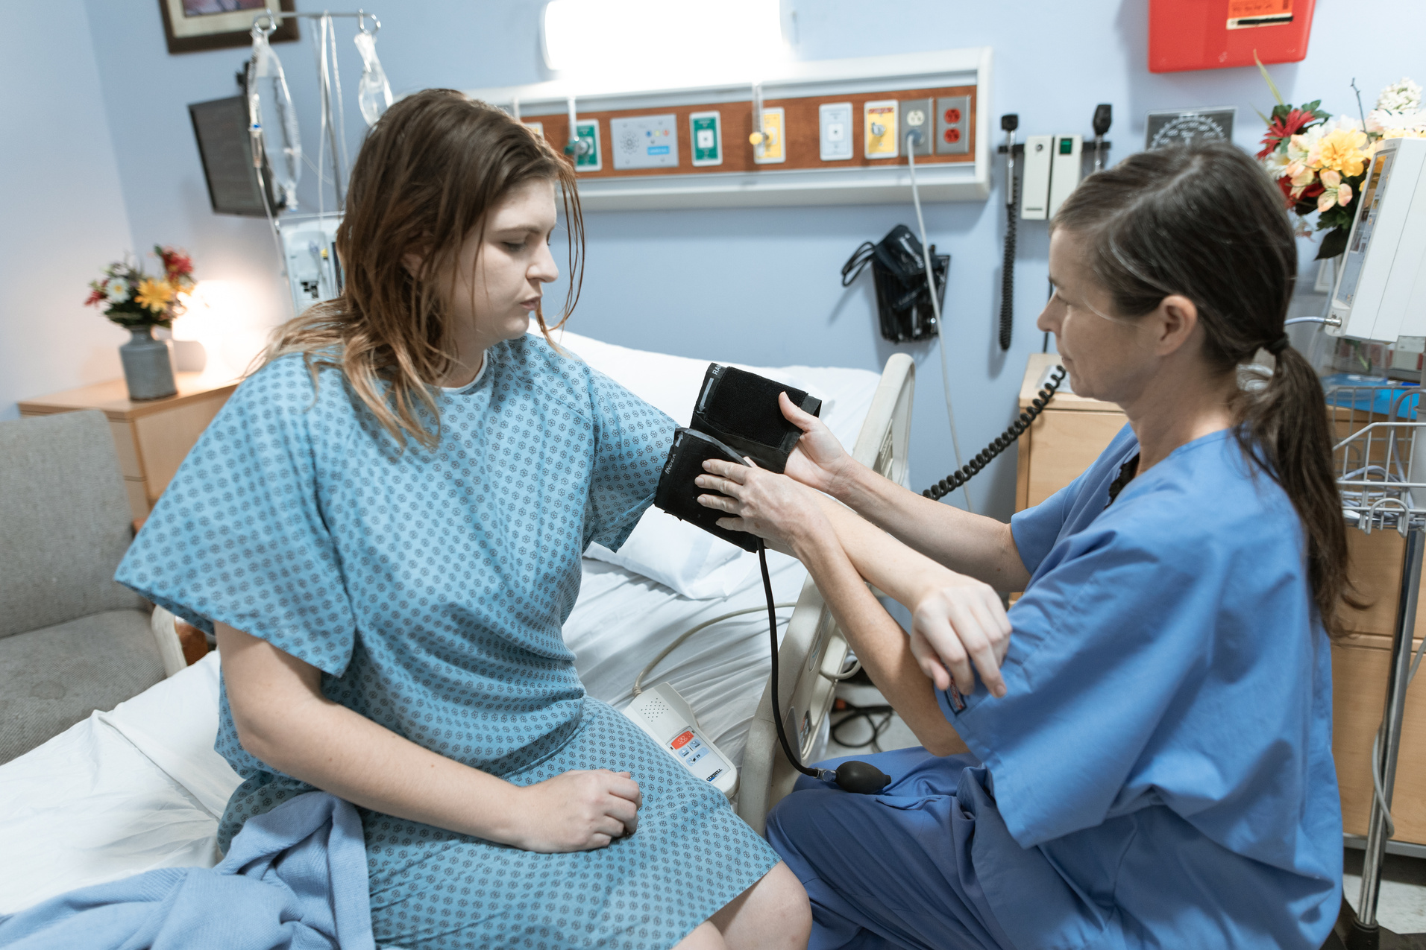
EXCELLENCE IN CARE
EXCELLENCE IN NURSING is about providing care that reflects the highest standards of clinical knowledge, compassion, and technical skill. Nurses achieve excellence through:
- Ongoing professional development, including certifications and advanced education.
- Evidence-based practice, ensuring that patient care is grounded in the latest research and best practices.
- Collaborative teamwork, working alongside other healthcare professionals to ensure holistic care.

Slide 11
KEY ELEMENTS OF EXCELLENCE
Evidence-Based Practice
Professional Competence
Holistic Care Approach
Using research and best practices to guide decisions & Delivering high-quality care informed by the latest research and best practices.
Maintaining high skill levels through education and training
Providing care that addresses all aspects of a person’s well-being—physical, emotional, and social needs ro ensure comprehensive health outcomes

Slide 12
KEY ELEMENTS OF EXCELLENCE
Leadership
& Innovation
Purpose
Continuous Education
Driving improvements in healthcare systems and fostering environments that inspire top-tier nursing care.
To ensure the best possible outcomes for patients and the community.
Encouraging lifelong learning to adapt to evolving medical advancements and patient needs.

Slide 13



ADVOCACY, EQUITY, AND EXCELLENCE: INTERCONNECTED
ROLES
ADVOCACY
EQUITY
EXCELLENCE

Slide 14
HOW ADVOCACY, EQUITY, AND EXCELLENCE WORK
TOGETHER
"Advocacy is the voice, Equity is the balance, and Excellence is the standard"
Advocacy, equity, and excellence are inseparable in nursing practice. Nurses speak up for patients' needs, ensuring fair treatment, while providing quality care to all, regardless of background. This care is tailored to each patient's unique needs, delivered with the highest standard of excellence.

Slide 15


NURSES' IMPACT:
NURSES MAKING A DIFFERENCE
Dr. Damilare Akingbade
Certified Global Nurse

Slide 16

NURSES' IMPACT:
NURSES MAKING A DIFFERENCE
Sarah Kumi
LinkedIn Nurse

Slide 17


NURSES' IMPACT:
NURSES MAKING A DIFFERENCE
Oladotun Ajayi
Social Entrepreneur

Slide 18


NURSES' IMPACT:
NURSES MAKING A DIFFERENCE
Jadesola Arowolo
Nuse Advocate

Slide 19

THE FUTURE OF NURSING: ADVANCING ADVOCACY, EQUITY, AND EXCELLENCE
As we look to the future, nurses will continue to be the driving force behind advocacy, equity, and excellence in healthcare.
Nurses will continue to shape the future of healthcare by staying committed to advocacy, striving for equity, and setting the bar for excellence in care.

Slide 20
THE FUTURE OF NURSING: ADVANCING ADVOCACY, EQUITY, AND EXCELLENCE
Innovation in care delivery
Leadership in Healthcare Policy
telemedicine, home health care, and advanced technologies to reach patients in new ways.
Expanding Roles
advocating for reforms that will improve access to care and reduce disparities.
nurses taking greater leadership in care coordination, public health initiatives, and patient education.

Slide 21

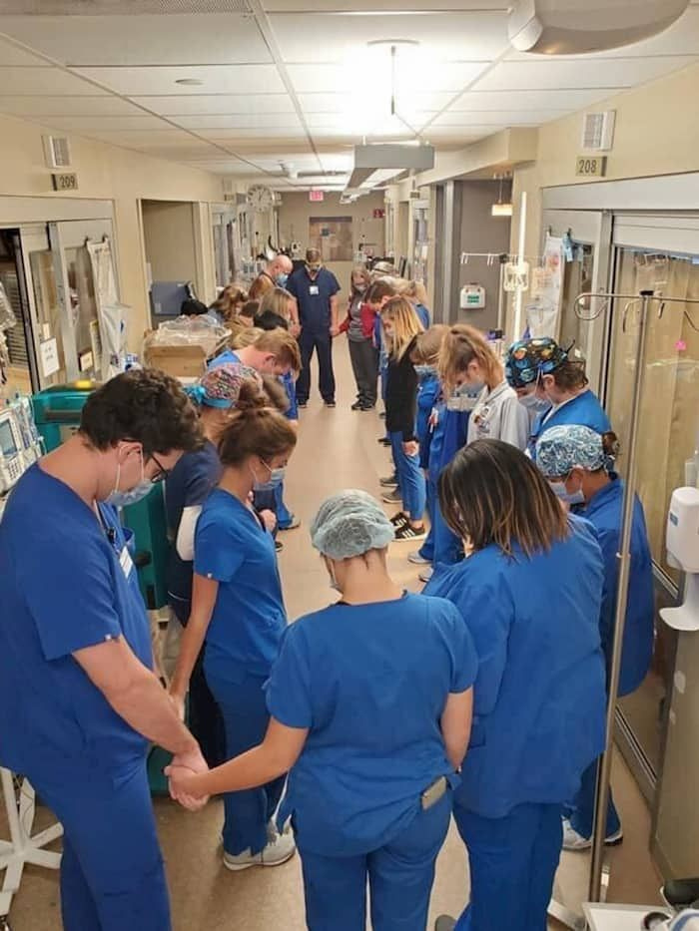

CONCLUSION
I envision a nursing profession that truly transforms lives. A profession that not only heals bodies, but also uplifts spirits and empowers communities, creating a world where compassion knows no bounds, kindness is contagious, and every life is touched by the healing power of nursing.
This is the Nursing I see.

Slide 22

THANK
YOU
&
HAPPY NURSES WEEK

